Slide 1
Agentic AI Hackathon: Building Intelligent Agents with IBM Granite and LangFlow
Project Title: X-Traffic: Explainable Agentic Congestion Intelligence

Slide 2



Name of the team: clanker_wanker
Details of Team members
TEAM MEMBER NAME | Recent Passport Photo | Email ID | Phone number [WhatsApp]
Suraj B |  | surajb.cd23@bmsce.ac.in | 8904712029
Hrishikesh R Prasad |  | hrishikeshr.cs23@bmsce.ac.in | 7892100520
Shashank U |  | shashanku.cs23@bmsce.ac.in | 9481441318

Slide 3
Problem statement
Trust Gap in Traffic Management
Current State: Traffic operators receive automated congestion alerts from hundreds of road segments daily.
The Gap: Current systems detect that congestion is occurring but fail to explain why it is happening.
The Consequence: This lack of causal explanation limits operator trust and hinders effective decision-making.
The Goal: A shift from reactive monitoring to informed action through explainable AI

Slide 4
Proposed solution
X-Traffic: Explainable Agentic Congestion Intelligence
We propose a multi-agent AI system where each agent performs a well-defined cognitive role, mirroring how a human traffic expert reasons.
Agent Responsibilities:
Agent 1: Traffic Data Analysis Agent
Observes traffic metrics (speed, volume, time, weather) and classifies congestion state.
Agent 2: Congestion Cause Analysis Agent
Correlates congestion patterns with contextual factors such as peak hour, weather, and incidents.
Agent 3: Explainable Insight Assistant
Generates clear, human-readable explanations supported by traffic engineering theory.
This separation ensures transparent, auditable reasoning instead of black-box outputs.

Slide 5
Need of project
Urban traffic congestion causes economic loss, fuel wastage, and delays
Operators need reasoned insights, not raw alerts
Trust in AI systems depends on interpretability
Government and city planners require explainable analytics for policy decisions
Aligns with smart-city and intelligent transport initiatives
Infrastructure decisions involve public safety. Operators need a traceable decision trail, not a black box system
This project converts reactive monitoring into informed action.

Slide 6
End user of project
Primary Users:
Traffic Control Centers
City Transportation Departments
Highway Operations Authorities
Secondary Users:
Urban Planning Agencies
Emergency Response Teams
Smart-City Governance Bodies
Indirect Beneficiaries:
Daily commuters
Logistics and transport services

Slide 7
Technology Used
Platform & Infrastructure:
IBM Cloud
IBM watsonx.ai
Agent Orchestration:
LangFlow platform
AI Model:
IBM Granite Model : ibm-granite-3-2-8b-instruct
Explainability Framework:
RAG (Retrieval Augmented Generation)
Traffic engineering literature (FHWA)

Slide 8
Novelty and Uniqueness
Traditional Traffic AI | X-Traffic System
Detects congestion | Detects as well as explains congestion causes
Acts as a Single black-box model | Functions as a Multi-agent reasoning system
It doesn’t provide any justification for congestion | Provides comprehensive literature-backed explanations
Use case: Alert-only systems | Use case: Intelligent and Actionable recommendation system

Slide 9
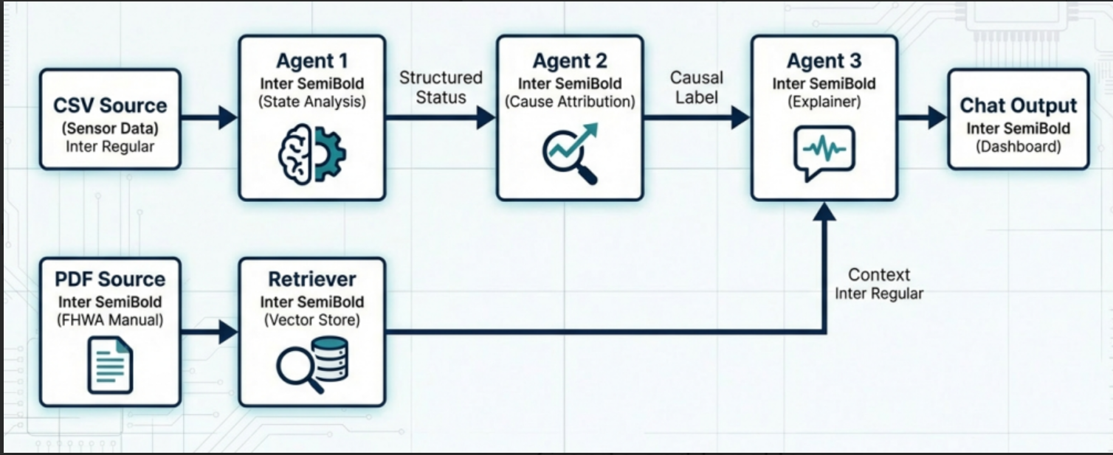
Technical flow diagram - Architecture blueprint

Slide 10
Langflow component Used
1. Chat Input:
Accepts natural-language operator queries
Example: “Analyze traffic for NH48 at 08:30”
2. IBM watsonx AI Agent:
Executes reasoning tasks using IBM Granite model
Each agent has a distinct system prompt and role\
3. File Component:
Loads structured traffic data (CSV)
Loads traffic literature (PDF)
4. Retriever (RAG Component):
Retrieves relevant theory passages
Supplies contextual grounding to Agent 3
5. Chat Output:
Displays final, human-readable explanations

Slide 11
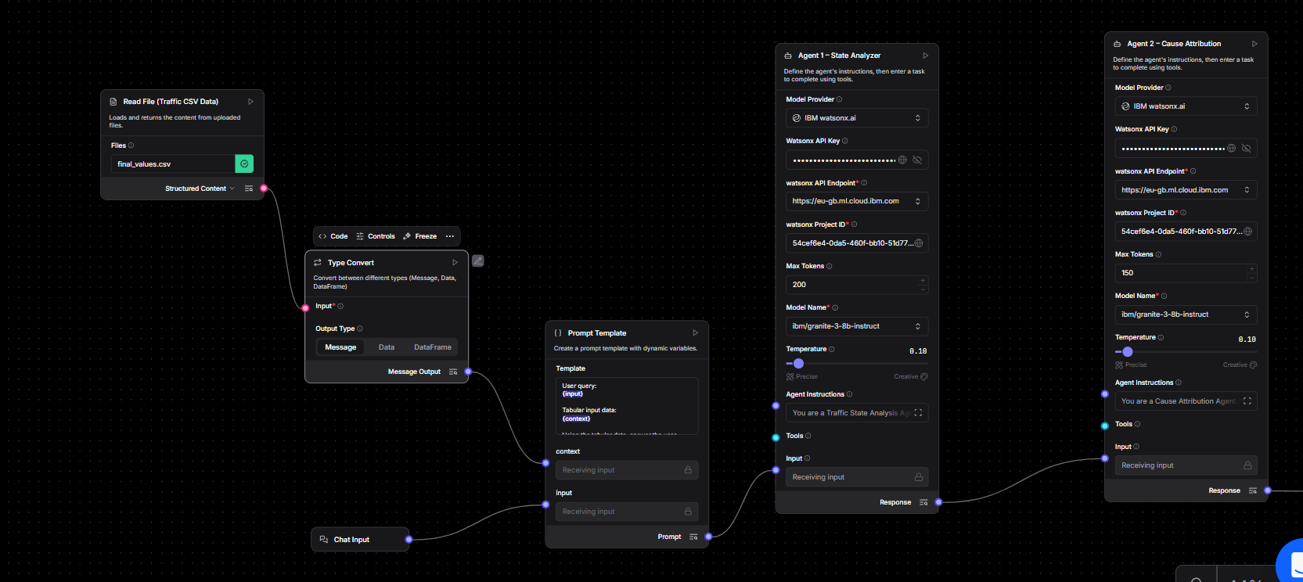
Input Screenshot 1

Slide 12
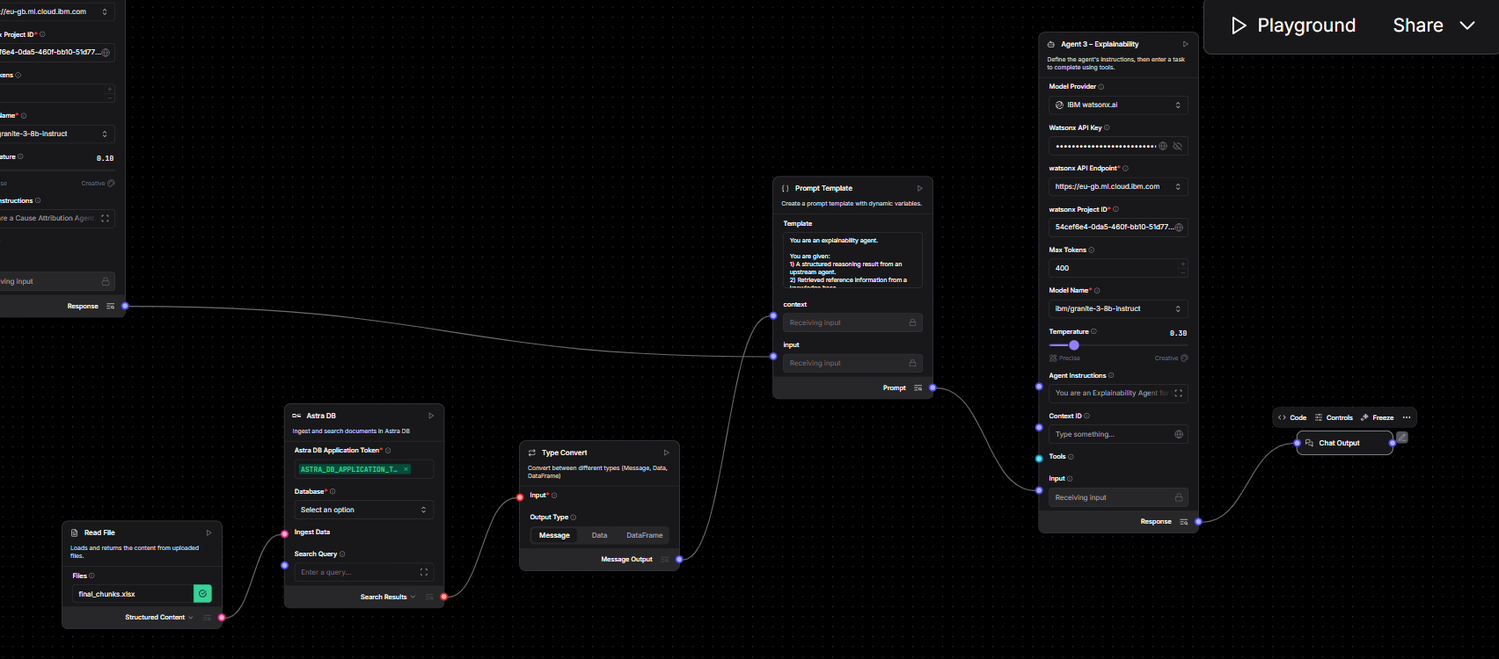
Input Screenshot 2

Slide 13
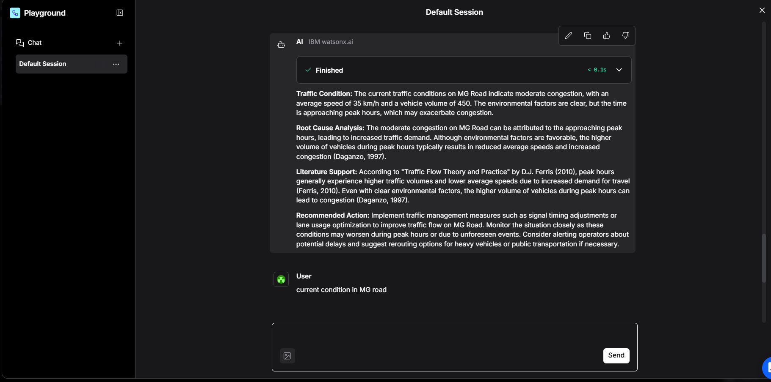
Output Screenshot 1

Slide 14
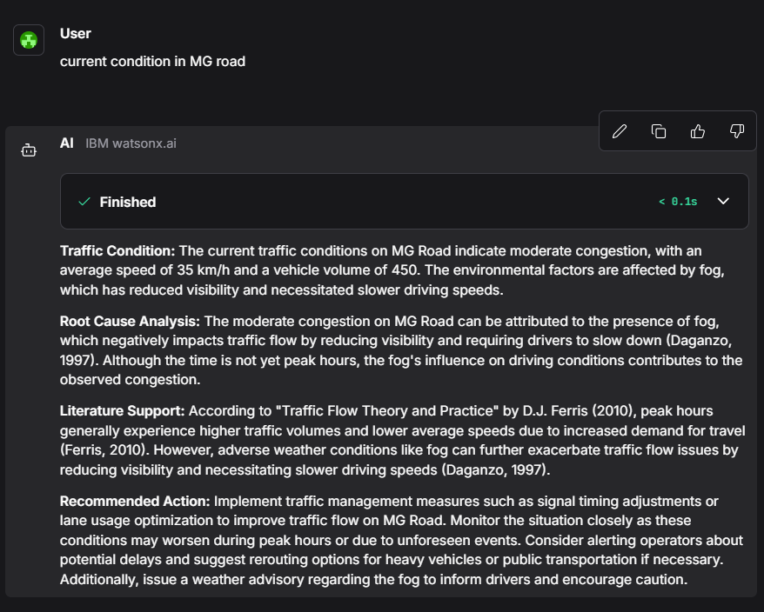
Input Screenshot 2

Slide 15
Future Scope
Some of the notable future scope of the project includes:
Real-time traffic sensor API integration
Predictive congestion forecasting
Expanded causal factors (events, construction, signal timing)
Multi-city scalability
Operator feedback loop for continuous learning
Integration with smart traffic dashboards
Integration with government traffic APIs and city-scale deployments
·
·
·

Slide 16
Git Hub Link
Repository link: https://github.com/hrishikeshrprasad367/IBM-hackathon
·
·
·

Slide 17
References
Federal Highway Administration (FHWA) – Traffic Flow Theory : link
IBM watsonx.ai Documentation: link
LangFlow Documentation: link
IBM Agentic AI Hackathon Guidelines
·
·
·

Slide 18


